Slide 1
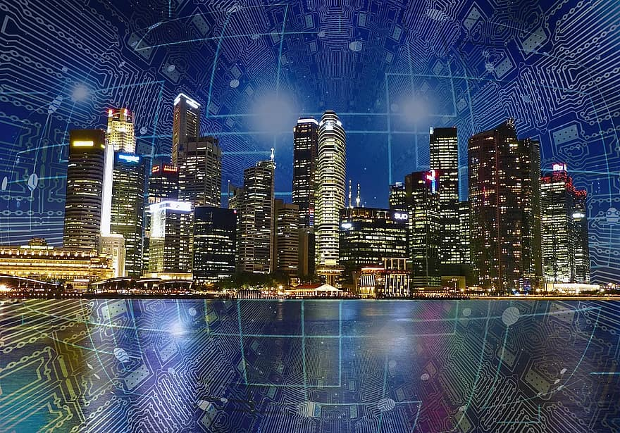
Smart city
Distributed Sensor Data Processing in a Smart City
Presented by
Varun S Hiremat
Rithesh T D
Ajay S
Soumya Bandigani
Sachidananda V K

Slide 2
CONTENTS
Introduction
Modules
Flowchart
Process1:Traffic Management
Process2:Waste Management
Process3:Environment management
Decision based on sensed data
Output Display

Slide 3
INTRODUCTION
A smart city is a place where traditional networks and services are made more flexible, efficient, and sustainable with the use of information, digital, and telecommunication technologies to improve the city's operations for the benefit of its inhabitants.
In this project we have taken three sensor data from multiple sources for processing in a smart city. such as traffic management, waste collection, and environmental monitoring.

Slide 4
MODULES
Traffic Management
Waste Collection
Environment Monitoring
Decision based on sensed data
Output Display

Slide 5
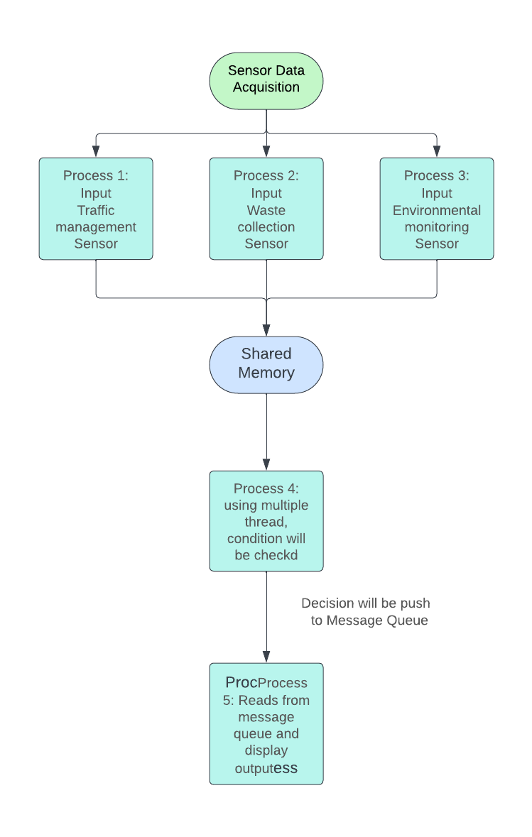
FLOW CHART

Slide 6
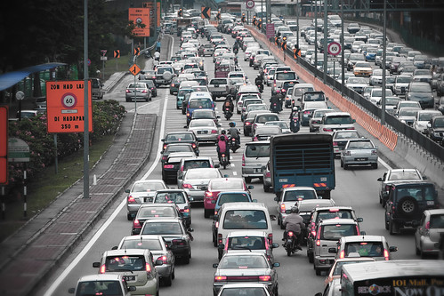
TRAFFIC MANAGEMENT
Traffic management systems optimize traffic flow, minimizing congestion and travel times for commuters. Improved Safety: Real-time data sharing and intelligent systems enhance safety by alerting drivers of potential hazards and enabling efficient incident management.
In our Project we have taken three cameras for detecting the traffic of three roads. Collected data is send to the shared memory. There condition will be check and . Based on that decision will be made.
This Photo by Unknown Author is licensed under CC BY-NC-ND

Slide 7
FLOW CHART
start
Collecting 1st traffic camera data
Collecting 2nd traffic camera data
Collecting 3rd traffic camera data
Shared memory

Slide 8
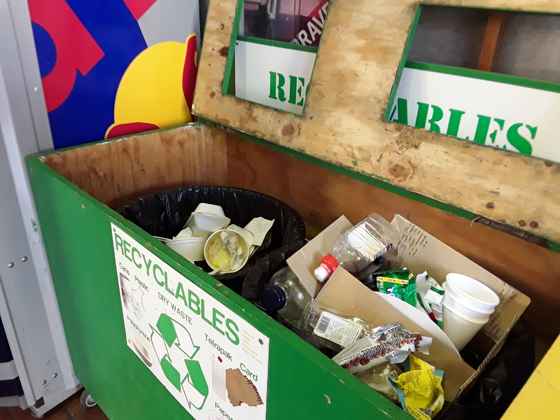
WASTE MANAGEMENT
As cities work to cost-efficiently manage waste in public spaces, smart city waste management programs can help to improve efficiency, and enhance the beauty of public areas
This work demonstrates a system that allows the waste management to monitor based on the level of the garbage depth inside the dustbin.
This Photo by Unknown Author is licensed under CC BY-ND

Slide 9
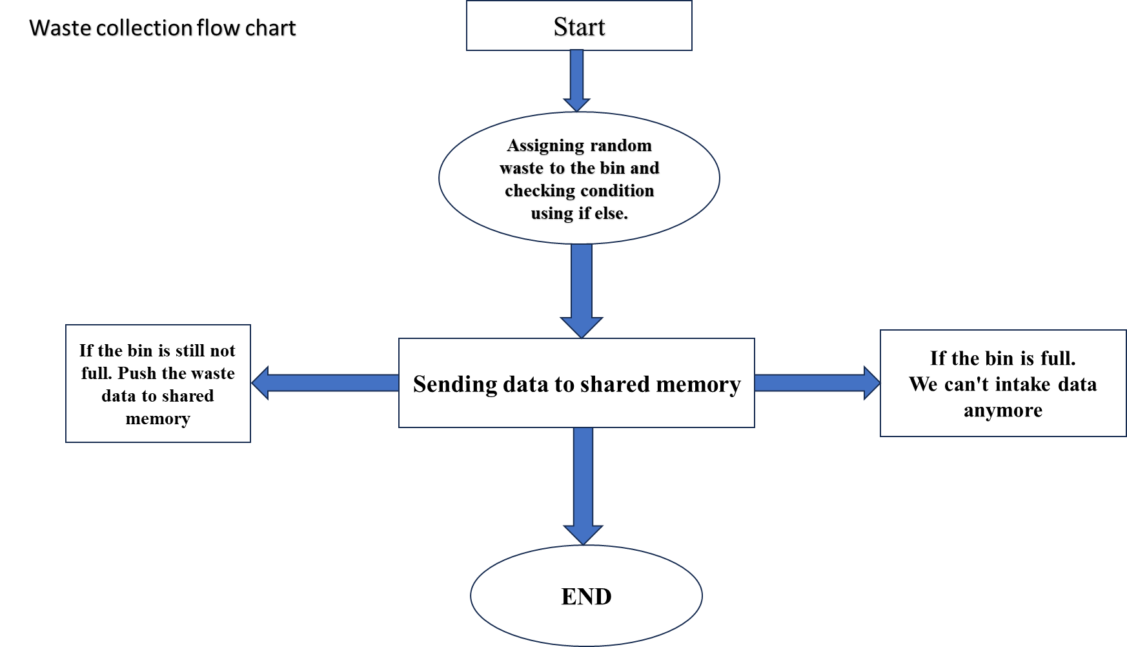

Slide 10
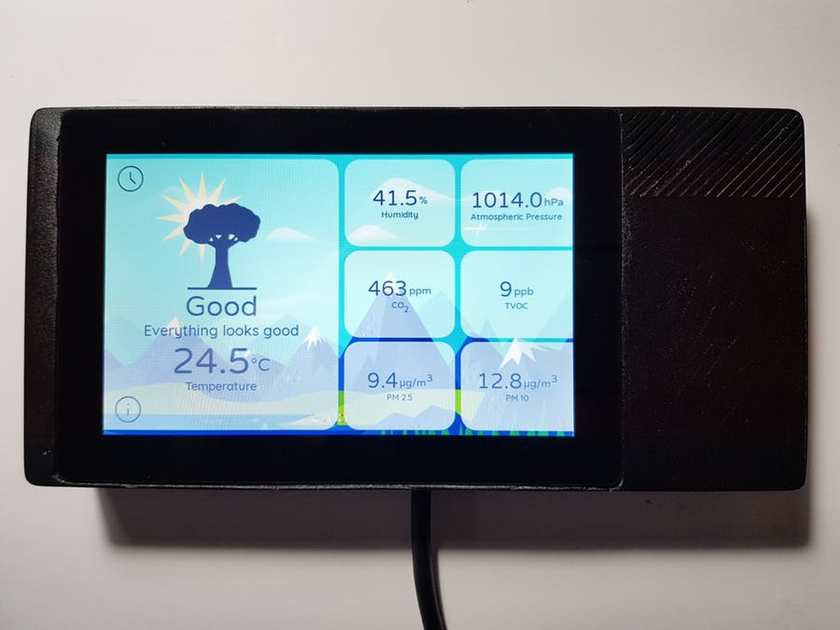
ENVIRONMENTAL MONITORING
Environmental monitoring describes the processes and activities that need to take place to characterize and monitor the quality of the environment.
In our project we have taken 3 parameters of environment .They are air, noise and weather. Here, collecting data from all of them and add it in to shared memory.
This Photo by Unknown Author is licensed under CC BY-SA

Slide 11
FLOW CHART
start
Collecting noise data
Collecting Air quality data
Collecting weather data
Shared memory

Slide 12
DECISION BASED ON SENSED DATA
This Module mainly focus on giving the efficient messages to the peoples in the smart city
The sensed data from different sensors will be taken and based on some standard parameters (for ex : Noise in DB : ranges from 0 where 0-50 is the low intensity , 50-80 is the medium etc ) and for the air Quality Index (0-100 is the good ,100-200 is the moderate and above 200 is unhealthy ) by comparing theses sensed parameter with the standard parameters .Efficient decision will be made for the peoples and these message will be pushed to the Message queue .

Slide 13
FLOW CHART
start
Collecting traffic data from shared memory
Collecting Waste data from shared memory
Collecting environment data from shared memory
Decision based on sensed traffic data
Decision based on sensed traffic data
Collecting noise data from shared memory
Message Queue

Slide 14
OUTPUT DISPLAY
The final decision which need to be notified for the public will be present in the message queue.
In the last process, these messages are read and displayed in the form of notification. Also stored inside the file for backup

Slide 15
FLOW CHART
start
Read data from Message Queue
Display final data
Add the data to a File

Slide 16
THANK YOU

